Slide 1
React & Redux
Keep your head cool and focused, there’s a tons of stuff to see today
Cedric Hartland

Slide 2
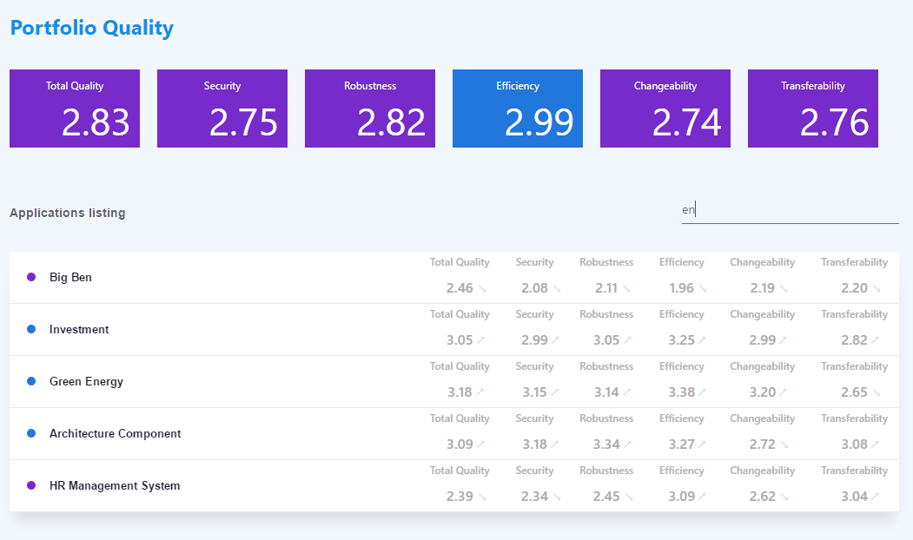
A project we’re targeting

Slide 3
React – a gentle introduction
Javascript library for building user interfaces

Slide 4
React – a library that defines views through components
In a declarative way
Components means reusability close to object oriented paradigm
Given an application state, renders some shadow DOM application state are inputs named properties
Business logic, state flow and DOM rendering are independent
Optimized rendering engine actually inspired from game engines
Little assumption on application structure can “easily” integrate with other technologies
Can render on server side SEO please
What else ? Not so much more

Slide 5
React – what’s actually good in it ?
Components
Enhanced reusability well, keep it generic if you plan on reusing… it’s all about OOP
Rendering lifecycle with optimizations
Basic type checking not so basic with propTypes
Becomes powerful with ES6 and more it’s not react, it’s ES6
Dependency management
Uptaded syntax and language features
Css inclusions
Arguably JSX
As opposed to string based templates
Don’t blame too quick, tsx exists too
Notes:
SOLID
Single responsibility
Open (for extensions) closed (for modifications)
Liskove substitutions – objects replacables with instances of subtypes
Interface segregation
Dependency investion – rely on abstractions

Slide 6
React – first thing first: JSX
Update to JS – ease the code readability for React
Elements, expressions, functions, etc.
CSS horror !! Js based CSS injection, good alternative with CSS imports/modular CSS
ES5
JSX
React.createElement(
"div",
{ "class": "app-head" },
React.createElement("h1", null, "Portfolio Quality" ),
React.createElement(
Tiles,
{ color: "blue" },
React.createElement(Tile, { value: 2.8294564, title: "Total quality" }),
React.createElement(Tile, { value: 2.75189, title: "Security" }),
React.createElement(Tile, { value: 2.82154, title: "Robustness" }),
React.createElement(Tile, { value: 2.98678, title: "Efficiency" }),
React.createElement(Tile, { value: 2.74234, title: "Changeability" }),
React.createElement(Tile, { value: 2.76354, title: "Transferability" })
)
);
<div class="app-head" >
<h1>Portfolio Quality</h1>
<Tiles color="blue" >
<Tile value={2.8294564} title="Total quality" />
<Tile value={2.75189} title="Security" />
<Tile value={2.82154} title="Robustness" />
<Tile value={2.98678} title="Efficiency" />
<Tile value={2.74234} title="Changeability" />
<Tile value={2.76354} title="Transferability" />
</Tiles>
</div>

Slide 7

A (not so) simple component
class Tile extends React.Component {
static propTypes = {
value: React.PropTypes.number,
title: React.PropTypes.string
};
render() {
return ( <div className="tile">
<div className="tile-header">{this.props.title}</div>
<div className="tile-value">{numeral(this.props.value).format('0.00')}</div>
</div>
);
}
}
Reusable class or function
Js Expressions in brackets
Properties types
Optional parenthesis wrapping
JSX declarations

Slide 8
Using this component
<div className="tiles">
<Tile value={2.8294564} title="Total quality" />
<Tile value={2.75189} title="Security" />
…
</div>
Properties
passed explicitely
to the component
Reuse component as an html element
From collection of data to collection of components
<div className="tiles">
{data.map((sample, index) => {
return <Tile key={index} {...sample} />;
})}
</div>
Properties are submitted implicitely from object
Key is required for collections
So React can omptimize re-rendering

Slide 9

Adding user interactions
class Filter extends React.Component {
…
render() {
return (
<div className="filter-input">
<input
type="text"
value={this.props.filterText}
placeholder={this.props.placeholder}
onChange={this.props.handleFilter}
/>
</div>);
}
}
Bind functions to events
Beware, binding to this use ES6 !

Slide 10
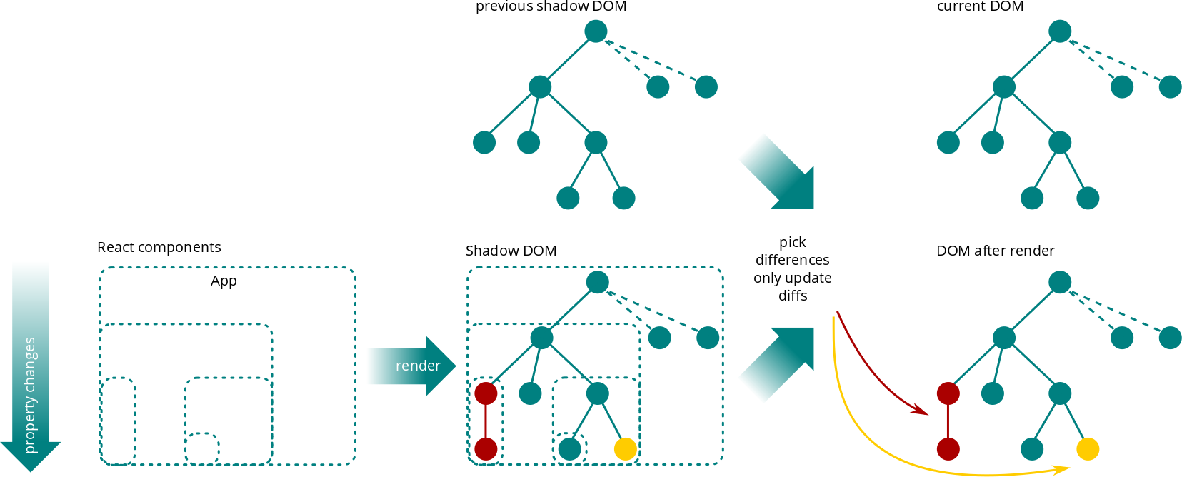
(re-)Rendering workflow

Slide 11
A few words on performance
Mounting (first render) is not cheap estimated x5 times slower than jquery
Creation of shadow DOM
Rendering of shadow DOM elements to actual DOM
Updating state
Component properties (inputs) changes trigger re-rendering comparing properties has negative impact on performance
Rendering creates a shadow DOM little impact on performance
Compare new shadow DOM to previous one negative impact on performance
Rendering of only differences to actual DOM strong positive impact on performance
Optimize via shouldComponentUpdate
Bring business logic and guess whether the component should call render at all not rendering when data are not changing has positive impact on performance

Slide 12
React
A few words before moving to next topic…
…just in case it was not that clear
React is designed in a declarative way
It can define it’s own internal state, but…
...most components should always return same content for given input and not have internal state dumb components, pure components
State only comes from data properties, state
No more jquery, backbone or whatever rendering tweaks on user interactions or from other sources
A single DOM source of truth is the output of render function
Application state only belong in data properties, state, dom reflects this

Slide 13
React – dumb & smart components
Application state is not held in component
Many components are said to be dumb
only display data
Dispatch events from user actions
Some smarter components
Operate other components and user actions functions
Some bind to data-source to manage application state updates

Slide 14
Few words on i18n
Available with key/value extractions package react-intl
Turn
Into
<Filter filterText={this.props.applications.filter}
handleFilter={this.handleFilter}
placeholder='Search...' />
<Filter filterText={this.props.applications.filter}
handleFilter={this.handleFilter}
placeholder={<FormattedMessage
id="applications.filterMesssage"
defaultMessage="Search…" />
} />
Propose ID and default message
Work with plurality and variables

Slide 15
React & Redux
Rock & Roll

Slide 16
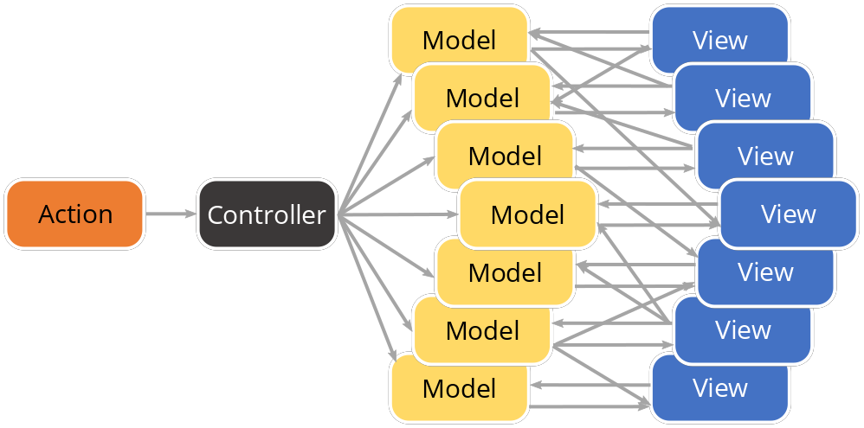
Redux – what the flux ?
Many frameworks and approaches follows MVC like patterns
Model manages behavior and data
View represent the display of the model in UI
Controller takes user input, manipulates model and cause views to update
MVC existed before I was born and still exist so it is kind of a norm
Bidirectional communications → causes cycles and create high complexity as met in AAD, AED, Highlight, etc. where 1 data change causes given views to render several times or indefinitely due to side effects
Notes:
MVC – around 1976

Slide 17
Redux – what the flux ?
React consumes data and produce DOM React updates DOM when data changes
Need for a data-source management workflow
Single source of truth
Whole application state in the centralized data store not hidden in DOM or other weird places
Flux, the original worflow :
Action
Dispatcher
View
Store

Slide 18
Redux – what the flux ?
React takes data and produce DOM
Need for a data-source-management workflow
Single source of truth
Flux, the worflow more in details
Dispatcher
Actions
Callbacks
Web API
Web API Utils
Action creators
Store
User Interactions
React views
Change events / Store queries

Slide 19
Redux - workflow close to that of flux
Motivation
MVC makes it hard to understand & debug application model update another model, then update a view that update a model, then…
SPAs high complexity data, interactions, asynchronicity, routing, etc. data mutation and asynchronicity makes it hard to reason about the application
Core principles
Single source of truth
The state of application stored in single object tree in single data store
State is read-only
Changing state requires an action that describes operation
Changes are made with pure functions
New state is new object no mutations

Slide 20
Redux – flux
Store is defined through
State
Reducers state mutator functions
Consumes current state
Consumes actions operations that could update state
Produces new state …or return the previous state if not changed
(state, action) → state’
Reducers can be combined
Divide & conquer
Reducers have to be pure functions
If states are different, their reference pointer are different
Benefit from predictability and testability
No need for deep object comparison through components lifecycle save on most expensive operation

Slide 21
Actions
Action basic structure
Type e.g. APPLICATION_FETCH
Payload e.g. { id: appId }
Action creators
Centralize business logic processing avoid diverging duplicates from discording places in code
Delegate type ↔ payload construction from dedicated functions
Actions payload processing is business logic related independent from data stores and views
Dispatching actions
Enforce loose coupling of code parts
Event based actions dispatching
Enable middleware based payload consumption and/or transformation

Slide 22
Redux – workflow
Action
Dispatcher
View
Store

Slide 23
Redux – workflow
Action
Dispatcher
Store
Reducers
R
R
View
R
State

Slide 24
Redux – workflow
Dispatcher
API
Action
middlewares
Logs
Delay actions
Store
Loop actions
Reducers
Crash report
R
R
R
…
View
State

Slide 25
Redux – workflow
Dispatcher
API
Action
middlewares
Logs
Delay actions
Store
Loop actions
event
Reducers
Crash report
R
R
R
…
View
State

Slide 26
Redux – workflow
action
Dispatcher
API
Action
middlewares
Logs
Delay actions
Store
Loop actions
Reducers
Crash report
R
R
R
…
View
State

Slide 27
Redux – workflow
action
API
Dispatcher
Action
middlewares
Logs
Delay actions
Store
Loop actions
Reducers
Crash report
R
R
R
…
View
State

Slide 28
Redux – workflow
Dispatcher
API
Action
middlewares
Logs
action
Delay actions
Store
Loop actions
Reducers
Crash report
state
R
R
R
…
View
State

Slide 29
Redux – workflow
Dispatcher
API
Action
middlewares
Logs
Delay actions
Store
Loop actions
Reducers
Crash report
R
R
R
…
View
State
new state

Slide 30
Redux – workflow
Dispatcher
API
Action
middlewares
action
Logs
Delay actions
Store
Loop actions
Reducers
Crash report
R
R
R
…
View
State

Slide 31
Redux – workflow
action
API
Dispatcher
Action
middlewares
Logs
Delay actions
Store
Loop actions
Reducers
Crash report
R
R
R
…
View
State

Slide 32
Redux – workflow
Dispatcher
API
Action
middlewares
Logs
action
Delay actions
Store
Loop actions
Reducers
Crash report
state
R
R
R
…
View
State

Slide 33
Redux – workflow
Dispatcher
API
Action
middlewares
Logs
Delay actions
Store
Loop actions
Reducers
Crash report
R
R
R
…
View
State
new state

Slide 34
Rock & Roll
React
Render components
Optimized rendering workflow
Redux
Optimize weak parts of react rendering
Together
Makes model – view transformations unidirectional
Optimize on view rendering and data processing
“easier” to debug and understand + efficient rendering

Slide 35
Application structure
sources
api/ // contains url information (builders) to (RESTful) API resources
business/ // contains data description and manipulations (redux workflow)
components/ // contains React dumb components
containers/ // contains React smart components
core/ // general application configuration skeleton
index.html // SPA entry point
main.jsx // SPA code entry point
store.js // redux data store setup

Slide 36
Business logic
sources
…
business/
any-concept/
specs/ // tests for business files, may be flat to folder or in such subfolder
actions.js // action creators (business logic operations there)
constants.js* // reusable constants (e.g. action variables)
reducers.js // reducer functions
sagas.js* // sagas middleware operations
..middleware.js // other possible middleware linked to business logic concept
…
Components with * are optional depending on context

Slide 37
API ?
Api lists / links API urls and querying of those it’s all about getting data
Use of ES6 fetch
Or use of frameworks or libraries such as axios…
axios('REST/applications')
.then((response) => {
return response.data.applications;
}).catch((error) => {
throw error;
});

Slide 38
Sagas ?
Operate side-effect operations
asynchronous operations e.g. manage data fetch from server
Cache accesses
Rely on generator pattern from ES6
Dispatch actions
Back to reducer
Generator function
function* sagas() {
yield put({type: 'APPLICATIONS_FETCH_PENDING'});
try {
yield fork (takeLatest, 'APPLICATIONS_FETCH', fetchApplications, ApiApplications);
}
catch (error) {
yield put({type: 'APPLICATIONS_FETCH_ERROR', payload: error});
}
}
Wait for command to be done before moving to next one
Define network reuse policy

Slide 39
Almost done…
Build, enhanced development process and how to test

Slide 40
Testing
As usual,
Need for unit tests mocha, jasmine, jed, enzyme, etc.
Need for integration tests
Selenium, Casperjs, Nightwatch, etc.
Consider mock servers option
Need for manual testing
Again, consider mock server option
Need to run tests on real browsers
Nothing really new out there

Slide 41
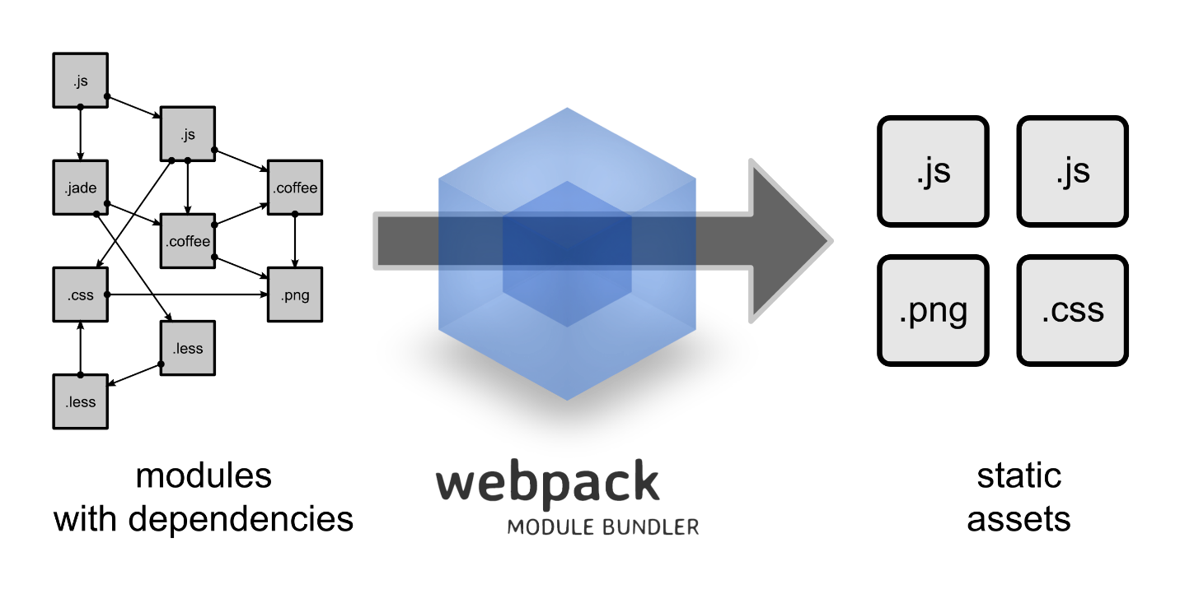
Packaging
Not so little development stack
jsx/es6/es2016/…
sass/less/modular (s)css/…
React, redux, react-router, and so much more
React/other component libraries
Development facilities hot reload
Need for debugging…
… and production build
Webpack proposes ways to manage all this

Slide 42
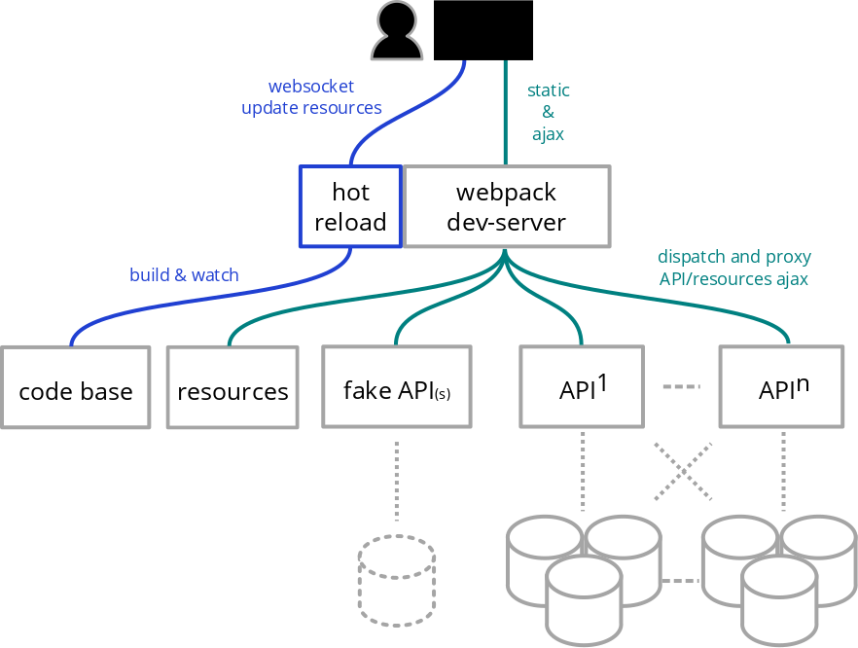
Development – faster, better, stronger
Webpack dev facilities
Hot reload inject changes in current app state
Continuously build
Bundling with debuging
Proxy to back-end
use 1 to many back-end implementations
Reduce development downtimes

Slide 43
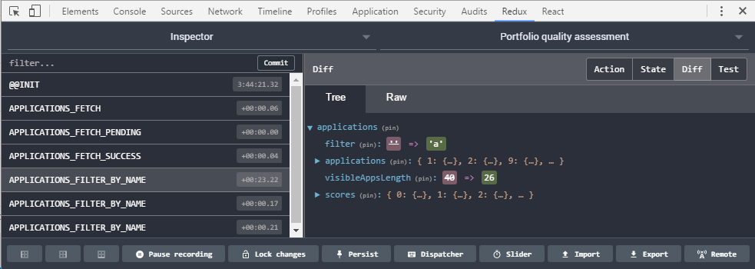
React – redux dev tools
Provide extra features to dev tools for debugging and scenario testing

Slide 44
Going further…
From newbie to less newbie

Slide 45
React
We saw most of it already
We could elaborate more on best practices…

Slide 46
Redux
Redux propose a framework for (web) application design
By the way: redux is the concept, Redux an implementation of that concept
Redux proposes data manipulation through reducer functions
Combining reducers can help more elaborate data processing
Normalizing data can help improving data manipulation and concistency
Document based model
Relational model mapping
Using immutability libraries may help staying on the tracks of functional programming and avoid pitfall bugs

Slide 47
Redux – reducers and combinations
One reducer a
State will be state = { a: {…} }
When reducer a activates, it’s input state is not state but state.a
Combine 2 reducers (a, b)
State will be state = { a: { … }, b: { … } }
Reducer a consumes state.a and reducer b state.b
Combine and sub-combine a, (b, c)
State will be
state = { a: { … }, bc: { b: { … }, c: { …} } }
or state = { a: { … }, b: { … }, c: { …} }
Reducer bc can exist as a sliced reducer that has access to state.b & state.c

Slide 48
Redux – Data normalization
Different reducers work on different state data
Complex data structures may require elaborate operations
Share actions across reducers
Data duplication across reducers
Those require extra synchronization effort when writing or updating code
Accessing data may not be easy or consistent by default
Normalizing data can help normalizr
Relational mapping to structure data client side database !
Get rid of data duplication
Separate collections from elements

